Slide 1
Network Monitoring with perfSONAR
ENhancing CyberInfrastructure by Training and Engagement (ENCITE) Webinar
Jason Zurawski – zurawski@es.net
Science Engagement Engineer, ESnet
March 13th 2015
This document is a result of work by the perfSONAR Project (perfSONAR at http://www.perfsonar.net). This document may be freely copied, modified, and otherwise re-used on the condition that any re-use acknowledge perfSONAR as the original source.

Slide 2
Agenda
Introduction & Motivation
Problem Classification
perfSONAR Basics
Deployment Strategies
Success Stories
Further Info
Notes:
Issues are

Slide 3
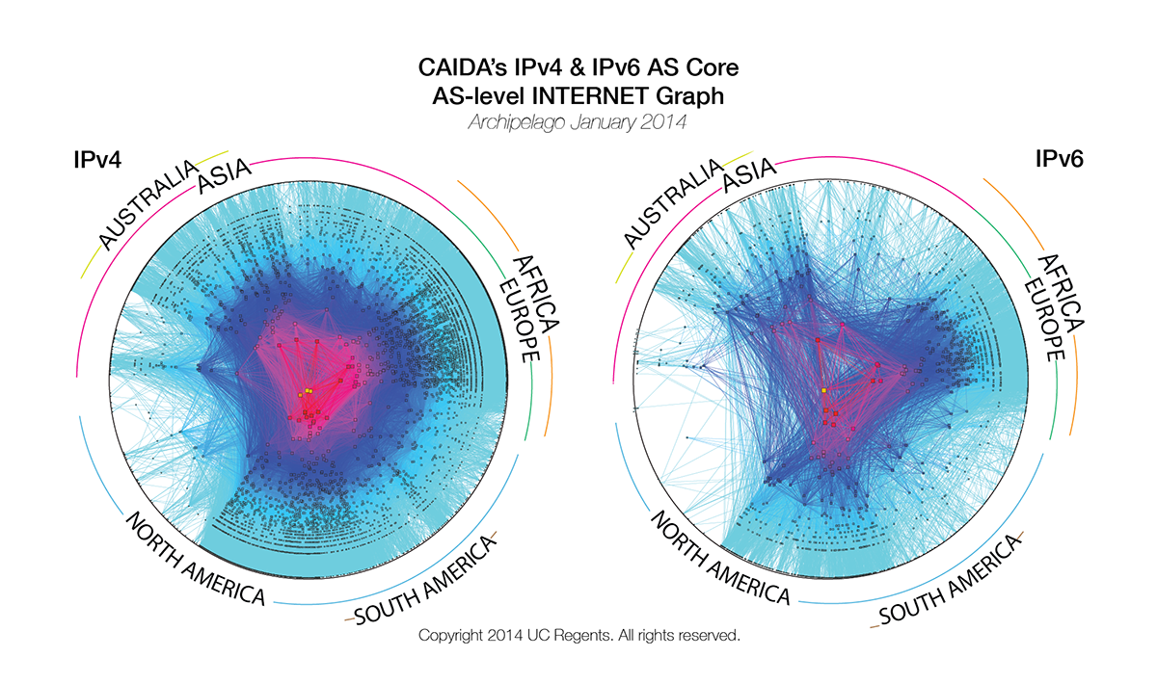
Problem Statement
The global Research & Education network ecosystem is comprised of hundreds of international, national, regional and local-scale networks.
Notes:
Issues are

Slide 4
Problem Statement
While these networks all interconnect, each network is owned and operated by separate organizations (called “domains”) with different policies, customers, funding models, hardware, bandwidth and configurations.
Notes:
Issues are

Slide 5
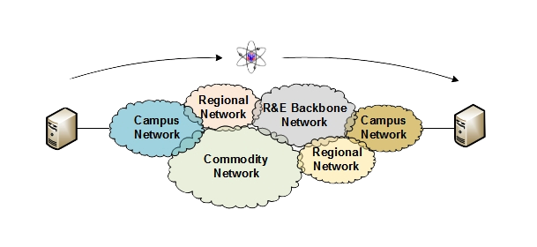
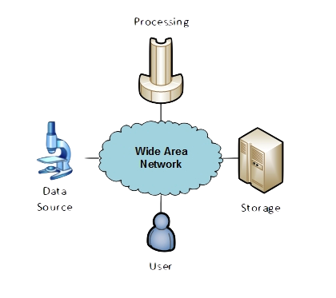
The R&E Community
The global Research & Education network ecosystem is comprised of hundreds of international, national, regional and local-scale resources – each independently owned and operated.
This complex, heterogeneous set of networks must operate seamlessly from “end to end” to support science and research collaborations that are distributed globally.
Data mobility is required; there is no liquid market for HPC resources (people use what they can get – DOE, XSEDE, NOAA, etc. etc.)
To stay competitive, we must learn the use patterns, and support them
This may mean making sure your network, and the networks of others, are functional
Notes:
Issues are

Slide 6
Lets Talk Performance …
"In any large system, there is always something broken.”
Jon Postel
Modern networks are occasionally designed to be one-size-fits-most
e.g. if you have ever heard the phrase “converged network”, the design is to facilitate CIA (Confidentiality, Integrity, Availability)
E.g. protecting the HVAC system from hackers = a good thing
Its all TCP
Bulk data movement is a common thread (move the data from the microscope, to the storage, to the processing, to the people – and they are all sitting in different facilities)
This fails when TCP suffers due to path problems (ANYWHERE in the path)
its easier to work with TCP than to fix it (20+ years of trying…)
TCP suffers the most from unpredictability; Packet loss/delays are the enemy
Small buffers on the network gear and hosts
Incorrect application choice
Packet disruption caused by overzealous security
Congestion from herds of mice
It all starts with knowing your users, and knowing your network

Slide 7
Where Are The Problems?
Congested or faulty links between domains
Latency dependant problems inside domains with small RTT
Source
Campus
Backbone
Destination
Campus
S
D
NREN
Regional
Congested intra- campus links

Slide 8
Local Testing Will Not Find Everything
Performance is poor when RTT exceeds ~10 ms
Performance is good when RTT is < ~10 ms
Source
Campus
R&E
Backbone
Destination
Campus
S
D
Switch with small buffers
Regional
Regional

Slide 9
A small amount of packet loss makes a huge difference in TCP performance
Local
(LAN)
With loss, high performance beyond metro distances is essentially impossible
International
Metro Area
Regional
Continental
Measured (TCP Reno)
Measured (HTCP)
Theoretical (TCP Reno)
Measured (no loss)
Notes:
This is an annotated version of the plot from the Science DMZ paper
Beyond your metro area, zero loss is essentially required for high performance
Where are your collaborators? Where are your users?
When global collaboration is the norm, nobody can afford to be a local-only resource

Slide 10
Agenda
Introduction & Motivation
Problem Classification
perfSONAR Basics
Deployment Strategies
Success Stories
Further Info
Notes:
Issues are

Slide 11
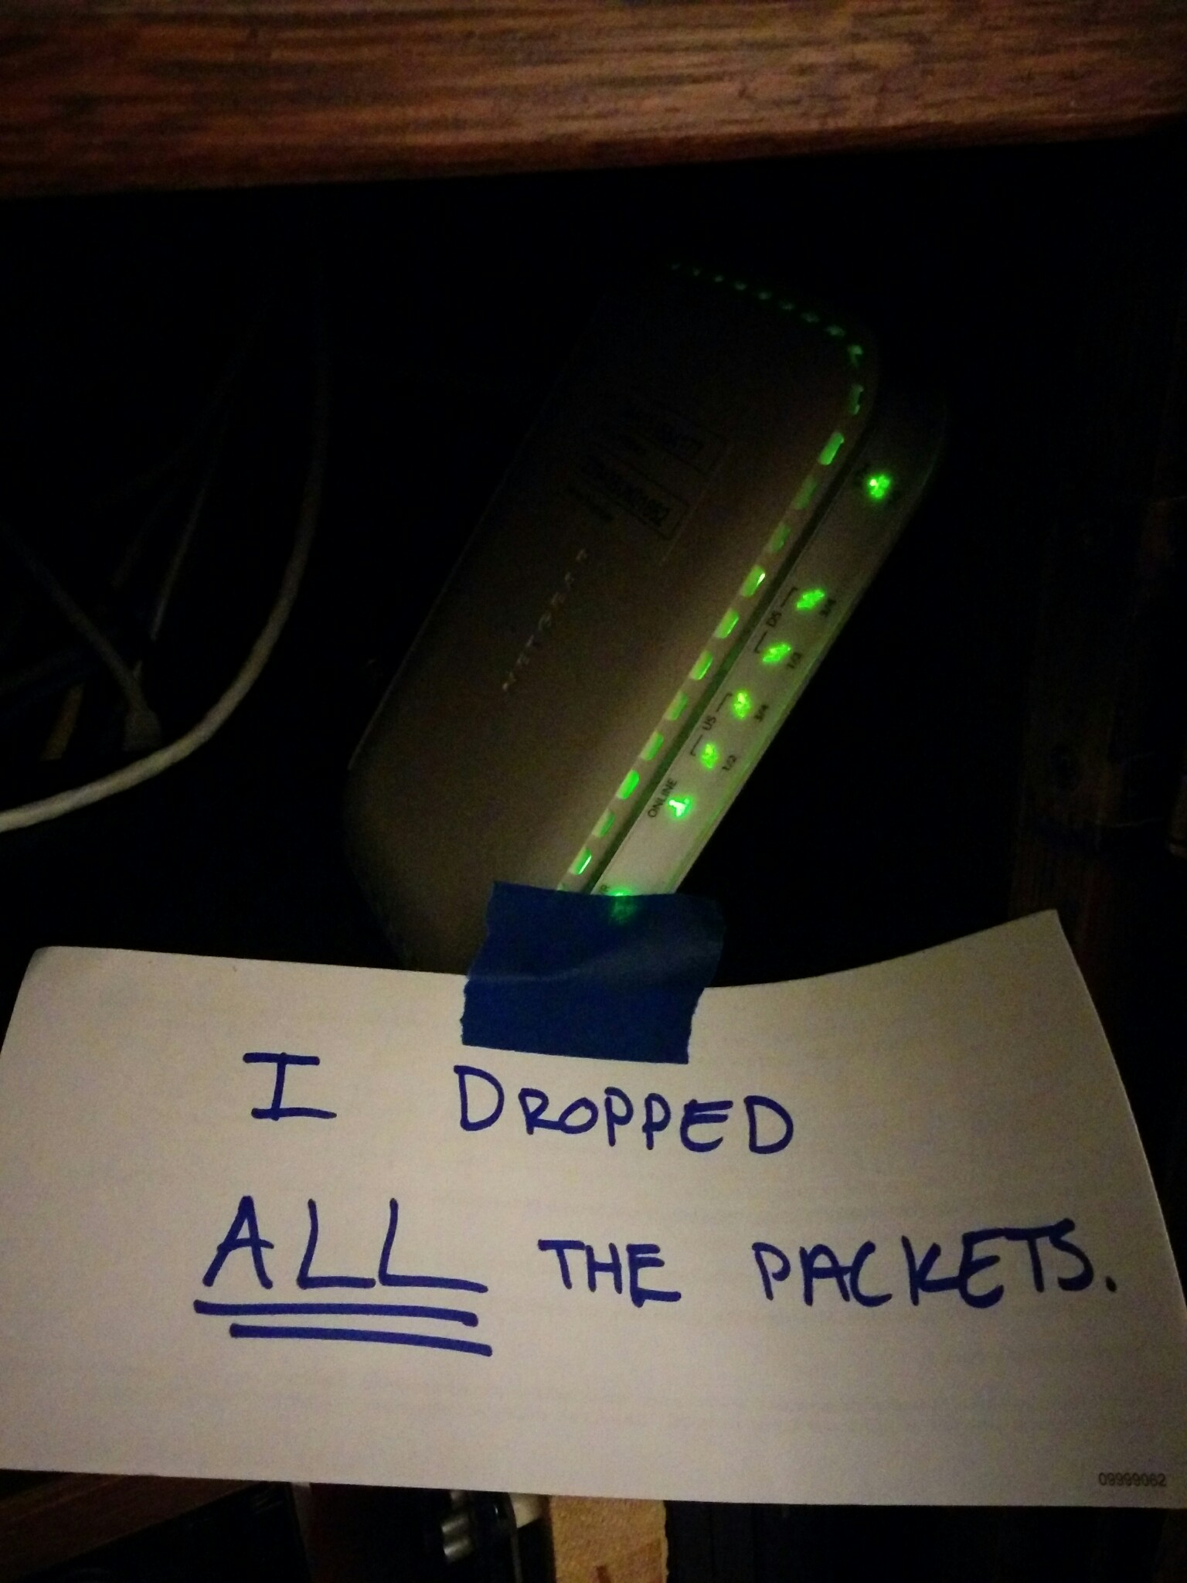
Soft Network Failures
Soft failures are where basic connectivity functions, but high performance is not possible.
TCP was intentionally designed to hide all transmission errors from the user:
“As long as the TCPs continue to function properly and the internet system does not become completely partitioned, no transmission errors will affect the users.” (From IEN 129, RFC 716)
Some soft failures only affect high bandwidth long RTT flows.
Hard failures are easy to detect & fix
soft failures can lie hidden for years!
One network problem can often mask others

Slide 12
Problem Statement: Hard vs. Soft Failures
“Hard failures” are the kind of problems every organization understands
Fiber cut
Power failure takes down routers
Hardware ceases to function
Classic monitoring systems are good at alerting hard failures
i.e., NOC sees something turn red on their screen
Engineers paged by monitoring systems
“Soft failures” are different and often go undetected
Basic connectivity (ping, traceroute, web pages, email) works
Performance is just poor
How much should we care about soft failures?
Notes:
Answer: we need to care *a lot* about soft failures – see next

Slide 13
Causes of Packet Loss
Network Congestion
Easy to confirm via SNMP, easy to fix with $$
This is not a ‘soft failure’, but just a network capacity issue
Often people assume congestion is the issue when it fact it is not.
Under-buffered switch dropping packets
Hard to confirm
Under-powered firewall dropping packets
Hard to confirm
Dirty fibers or connectors, failing optics/light levels
Sometimes easy to confirm by looking at error counters in the routers
Overloaded or slow receive host dropping packets
Easy to confirm by looking at CPU load on the host

Slide 14
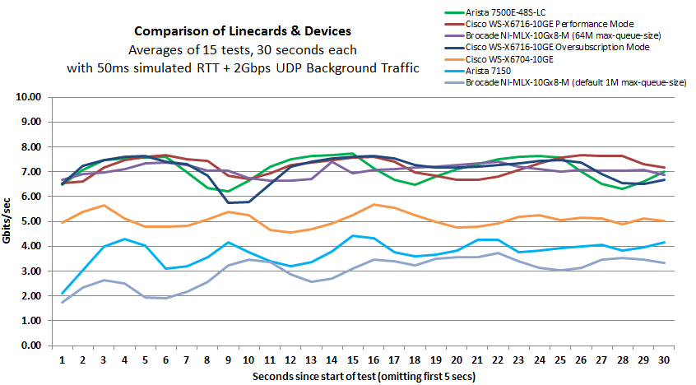
Under-buffered Switches are probably our biggest problem today
Notes:
Testing done by Michael Smitasin , LBL
1 10G TCP flow competing with 2GB background UDP

Slide 15
Abstraction Helps & Hurts
© 2013 University of Washington
Notes:
Need to look at our environment from different angles
Networks are large and complex, but well structured
The environment itself has mechanisms that can be used to address problems

Slide 16
Agenda
Introduction & Motivation
Problem Classification
perfSONAR Basics
Deployment Strategies
Success Stories
Further Info
Notes:
Issues are

Slide 17
Network Monitoring
All networks do some form monitoring.
Addresses needs of local staff for understanding state of the network
Would this information be useful to external users?
Can these tools function on a multi-domain basis?
Beyond passive methods, there are active tools.
E.g. often we want a ‘throughput’ number. Can we automate that idea?
Wouldn’t it be nice to get some sort of plot of performance over the course of a day? Week? Year? Multiple endpoints?
perfSONAR = Measurement Middleware

Slide 18
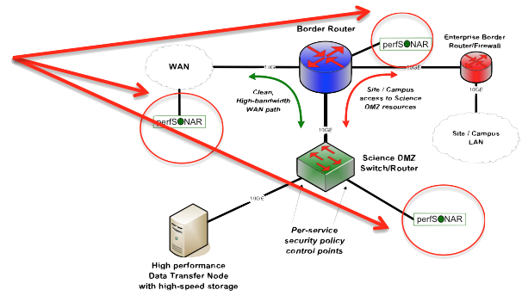
perfSONAR
All the “Science DMZ” network diagrams have little perfSONAR boxes everywhere
The reason for this is that consistent behavior requires correctness
Correctness requires the ability to find and fix problems
You can’t fix what you can’t find
You can’t find what you can’t see
perfSONAR lets you see
Especially important when deploying high performance services
If there is a problem with the infrastructure, need to fix it
If the problem is not with your stuff, need to prove it
Many players in an end to end path
Ability to show correct behavior aids in problem localization

Slide 19
What is perfSONAR?
perfSONAR is a tool to:
Set network performance expectations
Find network problems (“soft failures”)
Help fix these problems
All in multi-domain environments
These problems are all harder when multiple networks are involved
perfSONAR is provides a standard way to publish active and passive monitoring data
This data is interesting to network researchers as well as network operators
Notes:
Enables Federation
Service oriented
Designed with ‘multi-domain’ in mind
Brings together useful tools to address different needs
Several active and passive tools
Interface to configure regular testing
Diagnostic tools ready with ‘0 configuration’
Easy to install, easy to use
ISO image can be burned to CD/USB key
‘Wizard’ interface for configuration
Encouraging people to deploy ‘known good’ measurement points near domain boundaries
“known good” = hosts that are well configured, enough memory and CPU to drive the network, proper TCP tuning, clean path, etc.
Community Adoption
Over 600 instances seen world wide as of early May
20+ countries
100s of domains

Slide 20
perfSONAR History
perfSONAR can trace its origin to the Internet2/GN2 JRA1/GGF efforts (~2000)
What has changed since 2000?
The Good News:
TCP is much less fragile; Cubic is the default CC alg, autotuning is and larger TCP buffers are everywhere
Reliable parallel transfers via tools like Globus Online
High-performance UDP-based commercial tools like Aspera
The Bad News:
The wizard gap is still large
Jumbo frame use is still small
Under-buffered and switches and routers are still common
Under-powered/misconfigured firewalls are common
Soft failures still go undetected for months
User performance expectations are still too low

Slide 21
Simulating Performance
It’s infeasible to perform at-scale data movement all the time – as we see in other forms of science, we need to rely on simulations
Network performance comes down to a couple of key metrics:
Throughput (e.g. “how much can I get out of the network”)
Latency (time it takes to get to/from a destination)
Packet loss/duplication/ordering (for some sampling of packets, do they all make it to the other side without serious abnormalities occurring?)
Network utilization (the opposite of “throughput” for a moment in time)
We can get many of these from a selection of active and passive measurement tools – enter the perfSONAR Toolkit

Slide 22
What IPERF Tells Us
Lets start by describing throughput, which is vague.
Capacity: link speed
Narrow Link: link with the lowest capacity along a path
Capacity of the end-to-end path = capacity of the narrow link
Utilized bandwidth: current traffic load
Available bandwidth: capacity – utilized bandwidth
Tight Link: link with the least available bandwidth in a path
Achievable bandwidth: includes protocol and host issues (e.g. BDP!)
All of this is “memory to memory”, e.g. we are not involving a spinning disk (more later)
45 Mbps
10 Mbps
100 Mbps
45 Mbps
source
sink
Narrow Link
Tight Link
(Shaded portion shows background traffic)

Slide 23
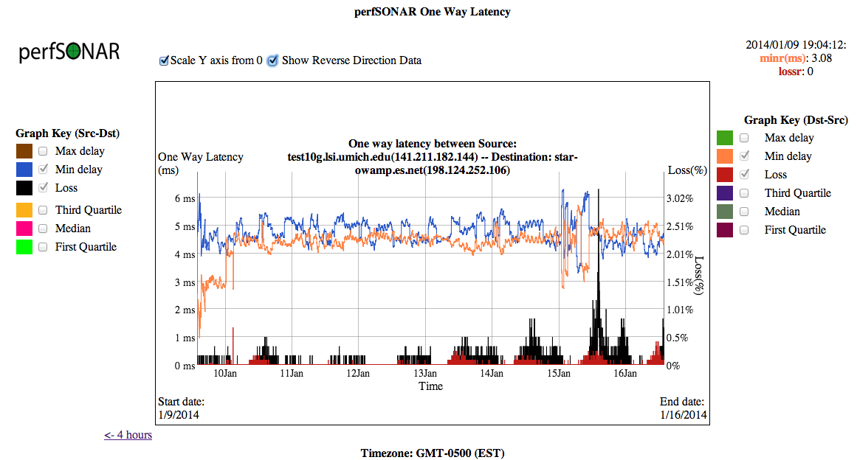
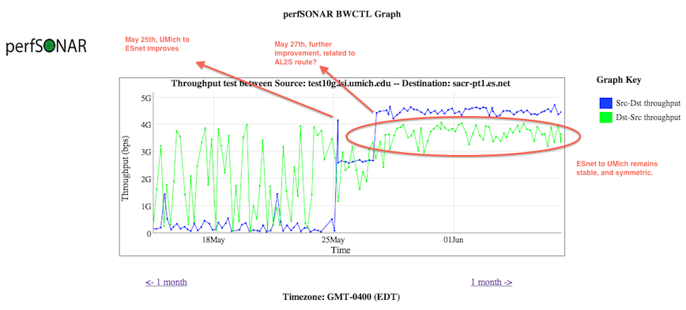
What OWAMP Tells Us

Slide 24
perfSONAR Toolkit
The “perfSONAR Toolkit” is an open source implementation and packaging of the perfSONAR measurement infrastructure and protocols
http://www.perfsonar.net
All components are available as RPMs, and bundled into a CentOS 6-based “netinstall”
perfSONAR tools are much more accurate if run on a dedicated perfSONAR host, not on the DTN or something else with a real job to do
Very easy to install and configure
Usually takes less than 30 minutes

Slide 25
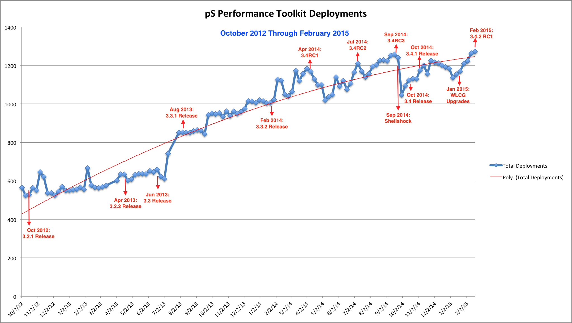
Deployment By The Numbers
Last updated Feb 2015. Adoption trend increases with each release. CC-NIE and innovation platform helped as well.

Slide 26
http://stats.es.net/ServicesDirectory/

Slide 27
Agenda
Introduction & Motivation
Problem Classification
perfSONAR Basics
Deployment Strategies
Success Stories
Further Info
Notes:
Issues are

Slide 28
Importance of Regular Testing
We can’t wait for users to report problems and then fix them (soft failures can go unreported for years!)
Things just break sometimes
Failing optics
Somebody messed around in a patch panel and kinked a fiber
Hardware goes bad
Problems that get fixed have a way of coming back
System defaults come back after hardware/software upgrades
New employees may not know why the previous employee set things up a certain way and back out fixes
Important to continually collect, archive, and alert on active throughput test results

Slide 29
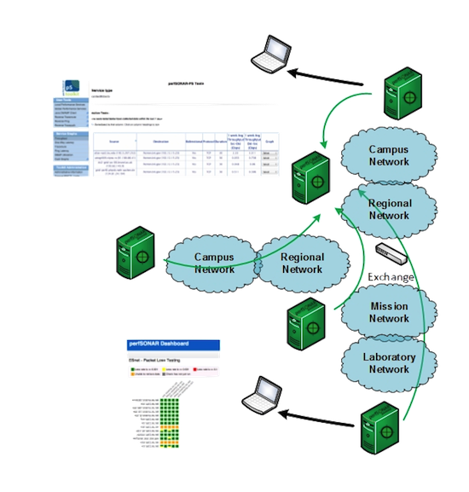
Regular Testing - Beacon
The beacon setup is typically employed by a network provider (regional, backbone, exchange point)
A service to the users (allows people to test into the network)
Can be configured with Layer 2 connectivity if needed
If no regular tests are scheduled, minimum requirements for local storage.
Makes the most sense to enable all services (bandwidth and latency)
© 2015, http://www.perfsonar.net
March 12, 2015
29

Slide 30
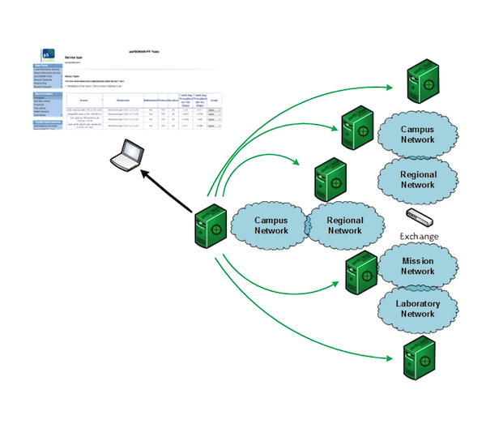
Regular Testing - Island
The island setup allows a site to test against any number of the 1300+ perfSONAR nodes around the world, and store the data locally.
No coordination required with other sites
Allows a view of near horizon testing (e.g. short latency – campus, regional) and far horizon (backbone network, remote collaborators).
OWAMP is particularly useful for determining packet loss in the previous cases.
Throughput will not be as valuable when the latency is small
© 2015, http://www.perfsonar.net
March 12, 2015
30

Slide 31
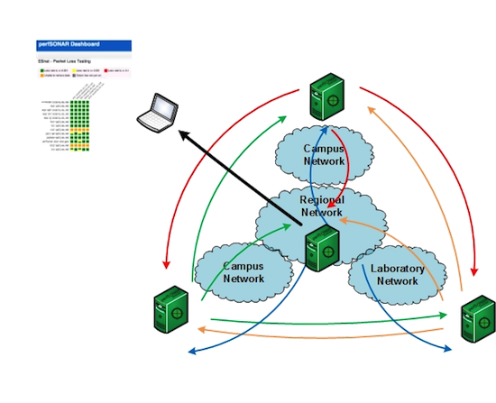
Regular Testing - Mesh
A full mesh requires more coordination:
A full mesh means all hosts involved are running the same test configuration
A partial mesh could mean only a small number of related hosts are running a testing configuration
In either case – bandwidth and latency will be valuable test cases
© 2015, http://www.perfsonar.net
March 12, 2015
31

Slide 32
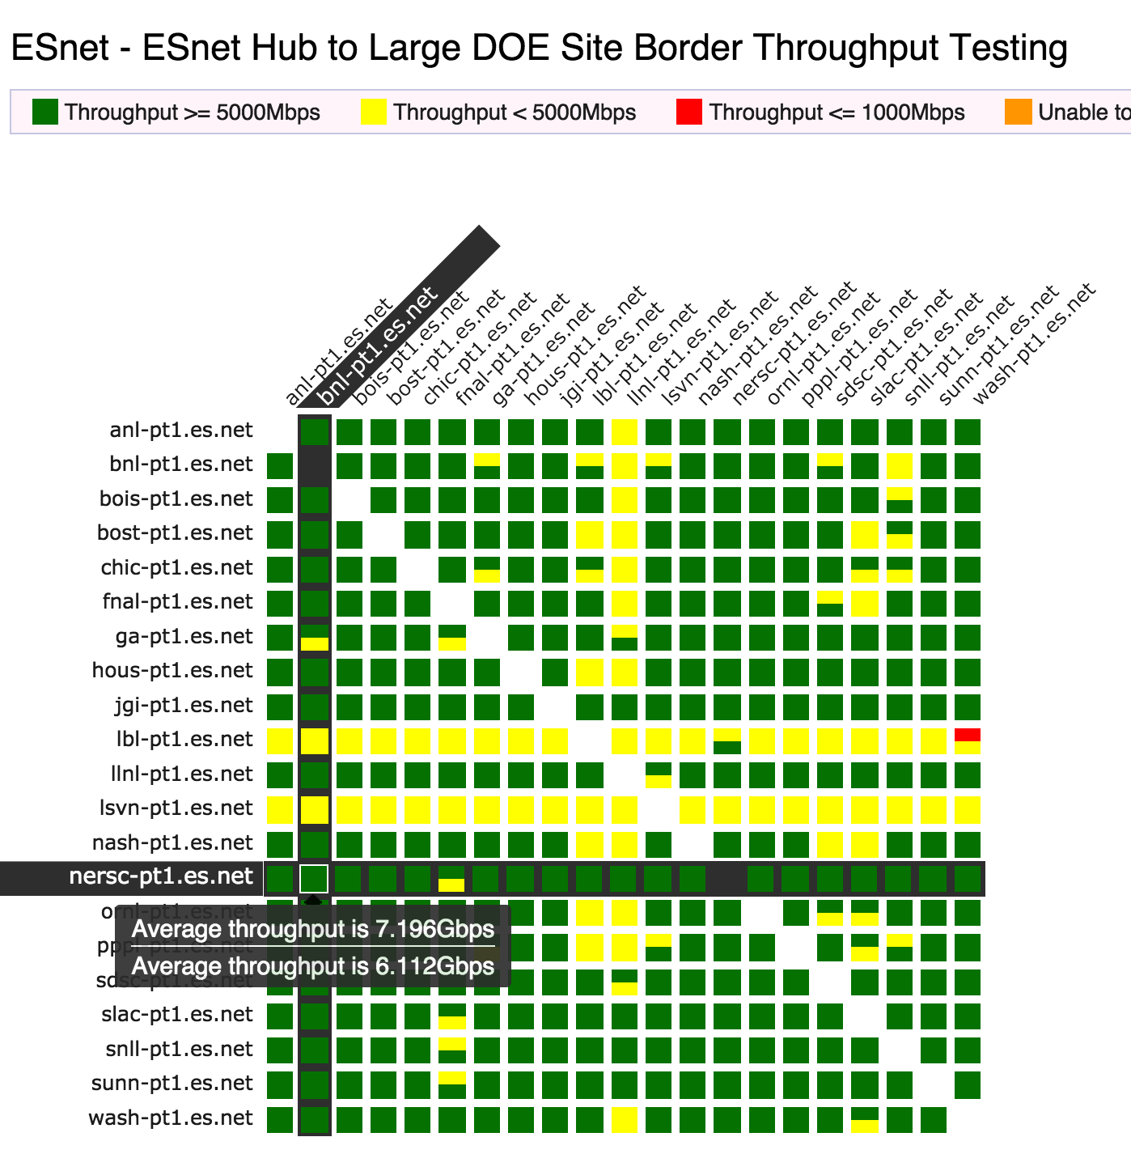
perfSONAR Dashboard: Raising Expectations and improving network visibility
Status at-a-glance
Packet loss
Throughput
Correctness
Current live instances at
http://ps-dashboard.es.net/
http://pas.net.internet2.edu/
Drill-down capabilities:
Test history between hosts
Ability to correlate with other events
Very valuable for fault localization and isolation

Slide 33
Develop a Test Plan
What are you going to measure?
Achievable bandwidth
2-3 regional destinations (careful – localized throughput testing is not very valuable – see earlier graph)
4-8 important collaborators
4-8 times per day to each destination (e.g. 4hr cadence = 6 tests per day)
20 second tests within a region, longer across oceans and continents
Loss/Availability/Latency
OWAMP: ~10-20 collaborators over diverse paths
Interface Utilization & Errors (via SNMP)

Slide 34
perfSONAR Deployment Locations
Critical to deploy near key resources such as DTNs
More perfSONAR hosts allow segments of the path to be tested separately
Reduced visibility for devices between perfSONAR hosts
Must rely on counters or other means where perfSONAR can’t go
Effective test methodology derived from protocol behavior
TCP suffers much more from packet loss as latency increases
TCP is more likely to cause loss as latency increases
Testing should leverage this in two ways
Design tests so that they are likely to fail if there is a problem
Mimic the behavior of production traffic as much as possible
Note: don’t design your tests to succeed
The point is not to “be green” even if there are problems
The point is to find problems when they come up so that the problems are fixed quickly
Notes:
A lot of people want to prove that they are not the problem, and design their tests to succeed. This is not helpful.

Slide 35
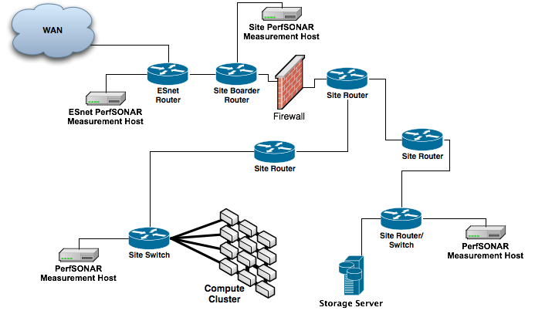
Sample Site Deployment

Slide 36
Agenda
Introduction & Motivation
Problem Classification
perfSONAR Basics
Deployment Strategies
Success Stories
Further Info
Notes:
Issues are

Slide 37
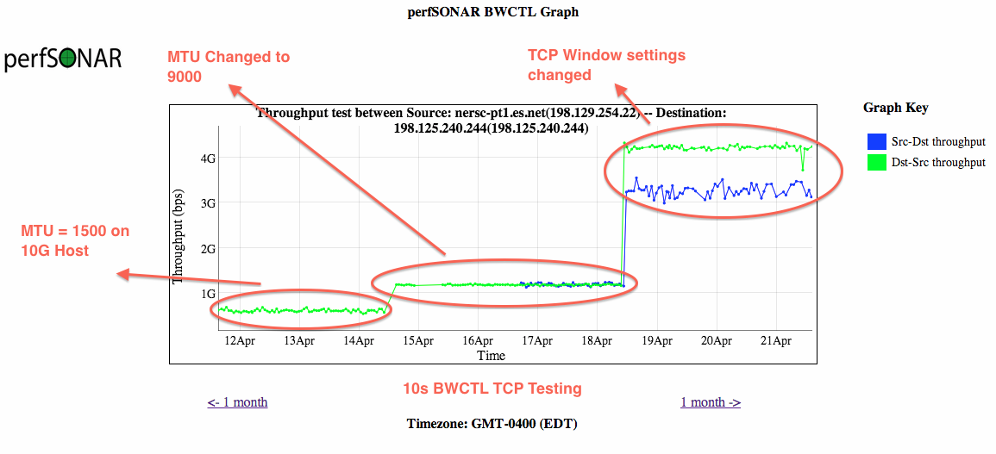
Success Stories - Host Tuning
Showing the role of MTUs and host tuning (e.g. ‘its all related’):

Slide 38
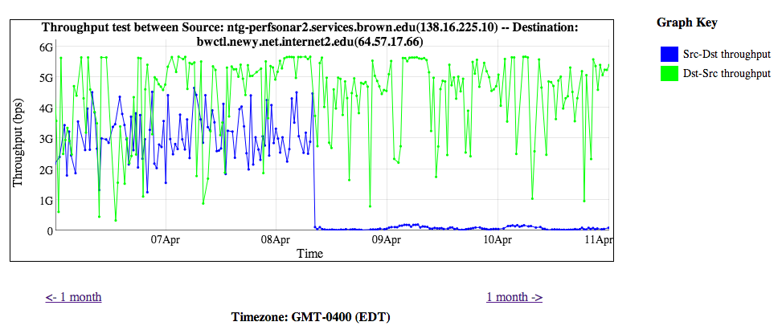
Success Stories - Upstream Packet Loss
Sometimes its not your fault – this is why monitoring your provider is a good idea:
Drastic drop in BWCTL normally has a reason …

Slide 39
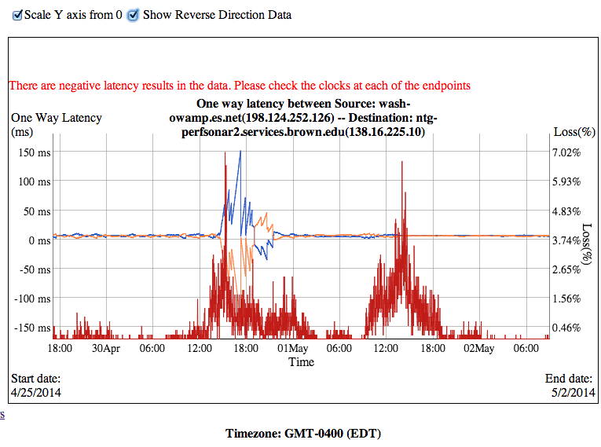
Success Stories - Upstream Packet Loss
Spikes of packet loss, almost always during business hours
Function of the load on the line/time of day
This was traced to regional network

Slide 40
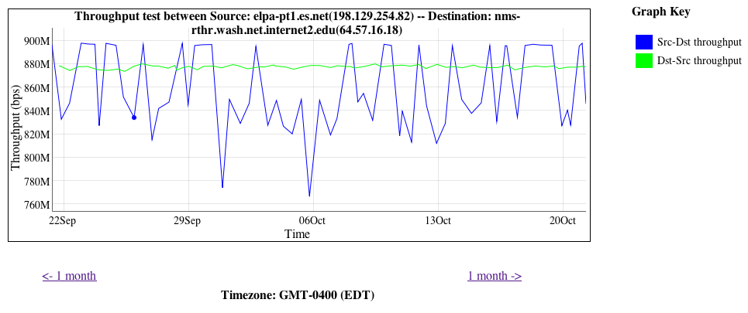
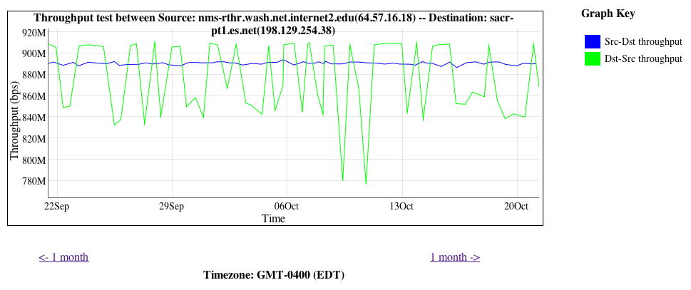
Success Stories - Speed Mismatch
http://fasterdata.es.net/performance-testing/troubleshooting/interface-speed-mismatch/
http://fasterdata.es.net/performance-testing/evaluating-network-performance/impedence-mismatch/

Slide 41
Success Stories - BGP Peering Migration
Performance increases
Performance stabilizes

Slide 42
Agenda
Introduction & Motivation
Problem Classification
perfSONAR Basics
Deployment Strategies
Success Stories
Further Info
Notes:
Issues are

Slide 43
Benefits: Finding the needle in the haystack
Above all, perfSONAR allows you to maintain a healthy, high-performing network because it helps identify the “soft failures” in the network path.
Classical monitoring systems have limitations
Performance problems are often only visible at the ends
Individual network components (e.g. routers) have no knowledge of end host state
perfSONAR tests the network in ways that classical monitoring systems do not
More perfSONAR distributions equal better network visibility.

Slide 44
Benefit: Active and Growing Community
Active email lists and forums provide:
Instant access to advice and expertise from the community.
Ability to share metrics, experience and findings with others to help debug issues on a global scale.
Joining the community automatically increases the reach and power of perfSONAR
The more endpoints means exponentially more ways to test and discover issues, compare metrics

Slide 45
perfSONAR Community
The perfSONAR collaboration is working to build a strong user community to support the use and development of the software.
perfSONAR Mailing Lists
Announcement Lists:
https://mail.internet2.edu/wws/subrequest/perfsonar-announce
Users List:
https://mail.internet2.edu/wws/subrequest/perfsonar-users

Slide 46
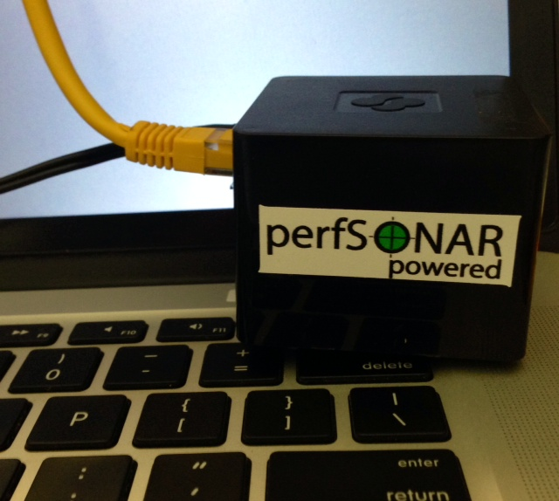
New explorations
Cheap ARM-based perfSONAR nodes
e.g.: Cubox (“perfCUBE”) $120
Several organizations have begun playing with these
TCP max = 350Mbps
owamp works well
ARM RPMs for Fedora20 at: http://downloads.es.net/pub/perfsonar/cubox/

Slide 47
Resources
perfSONAR website
http://www.perfsonar.net/
perfSONAR Toolkit Manual
http://docs.perfsonar.net/
perfSONAR mailing lists
http://www.perfsonar.net/about/getting-help/
perfSONAR directory
http://stats.es.net/ServicesDirectory/
FasterData Knowledgebase
http://fasterdata.es.net/

Slide 48
Network Monitoring with perfSONAR
ENhancing CyberInfrastructure by Training and Engagement (ENCITE) Webinar
Jason Zurawski – zurawski@es.net
Science Engagement Engineer, ESnet
March 13th 2015
This document is a result of work by the perfSONAR Project (perfSONAR at http://www.perfsonar.net). This document may be freely copied, modified, and otherwise re-used on the condition that any re-use acknowledge perfSONAR as the original source.

